Slide 1

University College of Engineering (BIT Campus) Anna University, Tiruchirappalli -620024
AI-Based Sentiment and Emotion Analysis of YouTube Comments
Under the Guidance:
Dr. K.Ambika
Assistant Professor
Department of CSE
Presented by:
810022104086- SEENU ANANTH K
IV year, B.E – CSE B

Slide 2
INTRODUCTION
YouTube has become one of the most popular platforms where people freely express their opinions, feelings, and reactions through comments and interactions.
These comments reflect public sentiment on various topics and help in understanding how opinions change over time.
Analyzing YouTube comments provides valuable insights into sentiment variations, key discussion topics, and the impact of user engagement such as likes and replies on overall sentiment trends.
The results of such analysis can be useful for researchers, policymakers, and businesses to understand public opinion and make informed decisions.

Slide 3
ABSTRACT
YouTube is a popular platform where users share opinions through comments on videos. Analyzing these comments helps understand public sentiment and emotions, but manual analysis is difficult due to large data volume, spam, and mixed languages. This project presents an AI-based system to analyze sentiment and emotions from YouTube comments using Natural Language Processing and Deep Learning techniques.
Comments are collected using the YouTube Data API, cleaned, and analyzed using TextBlob, VADER, BERT, and RoBERTa models. Engagement factors such as likes and replies are also considered. The results are displayed through an interactive dashboard for better understanding.

Slide 4
OBJECTIVES
To collect YouTube comments from user-provided video links for sentiment analysis.
To analyze and classify comments into positive, negative, neutral, and emotion-based sentiments.
To process multilingual comments such as English, Tamil and mixed-language comments like Thanglish.
To understand public opinion by analyzing sentiment patterns in YouTube comment sections.
To visualize sentiment results using graphs and dashboards for better understanding.

Slide 5
PROBLEM STATEMENT
Manual analysis of YouTube comments is time-consuming and inefficient.
Existing systems focus mainly on comment text and ignore engagement factors.
Spam, irrelevant comments, and mixed languages reduce sentiment accuracy.
Traditional models fail to capture deep emotions expressed in comments.
There is a need for an automated and intelligent system to analyze YouTube comments effectively.

Slide 6
PROPOSED WORK
Develop an AI-based system to analyze YouTube comments automatically.
Collect comments using the YouTube Data API by providing a video link.
Perform text preprocessing such as cleaning and normalization.
Use multiple NLP models for accurate sentiment classification.
Detect emotions and consider engagement factors for better insights.
Visualize results using an interactive dashboard.

Slide 7
LITERATURE SURVEY
S.NO | AUTHOR | TITLE | TECHNIQUES USED | PROS | LIMITATIONS
1 | Amangeldi et al., 2024 | Understanding Environmental Posts: Sentiment and Analysis of Social Media Data | Point wise Mutual Information (PMI) for sentiment classification | High accuracy in sentiment detection | Not focused on real-time tracking​ and Limited support for multilingual mixed-language comments.
2 | Ibrohim et al., 2024 | Sentiment Analysis for the Natural Environment: A Systematic Review | Lexicon-based and ML models (SVM, Decision Tree) | Explains different methods used for sentiment analysis clearly. | Does not propose an implementation system and does not integrate engagement metrics or dashboards.
3 | Bryan-Smith et al., 2023 | Real-Time Social Media Sentiment Analysis for Rapid Impact Assessment | Real-time sentiment tracking using NLP-based models | Gives fast sentiment results from social media data. | Applied to floods, does not support YouTube video-based input

Slide 8
4 | Arsen Tolebay Nurlanuly.,2025 | Sentiment Analysis of Texts from Social Networks Based on Machine Learning Methods | Machine learning and transformer-based models | Combines traditional ML and deep learning for sentiment analysis | Does not handle engagement factors and does not provide an end-to-end user interface
5 | Arun Kumar et al.,2024 | Emotion Detection from Text Using NLP Techniques | Lexicon-based and machine learning emotion detection | Identifies basic emotions from text | Limited to predefined emotions and no real-time YouTube comment analysis
6 | Vidhya et al.,2023 | Techniques Opinion Mining and Sentiment Analysis | Machine learning–based sentiment classification | Helps identify positive and negative opinions from text | Lacks real-time YouTube data analysis and no dashboard visualization

Slide 9
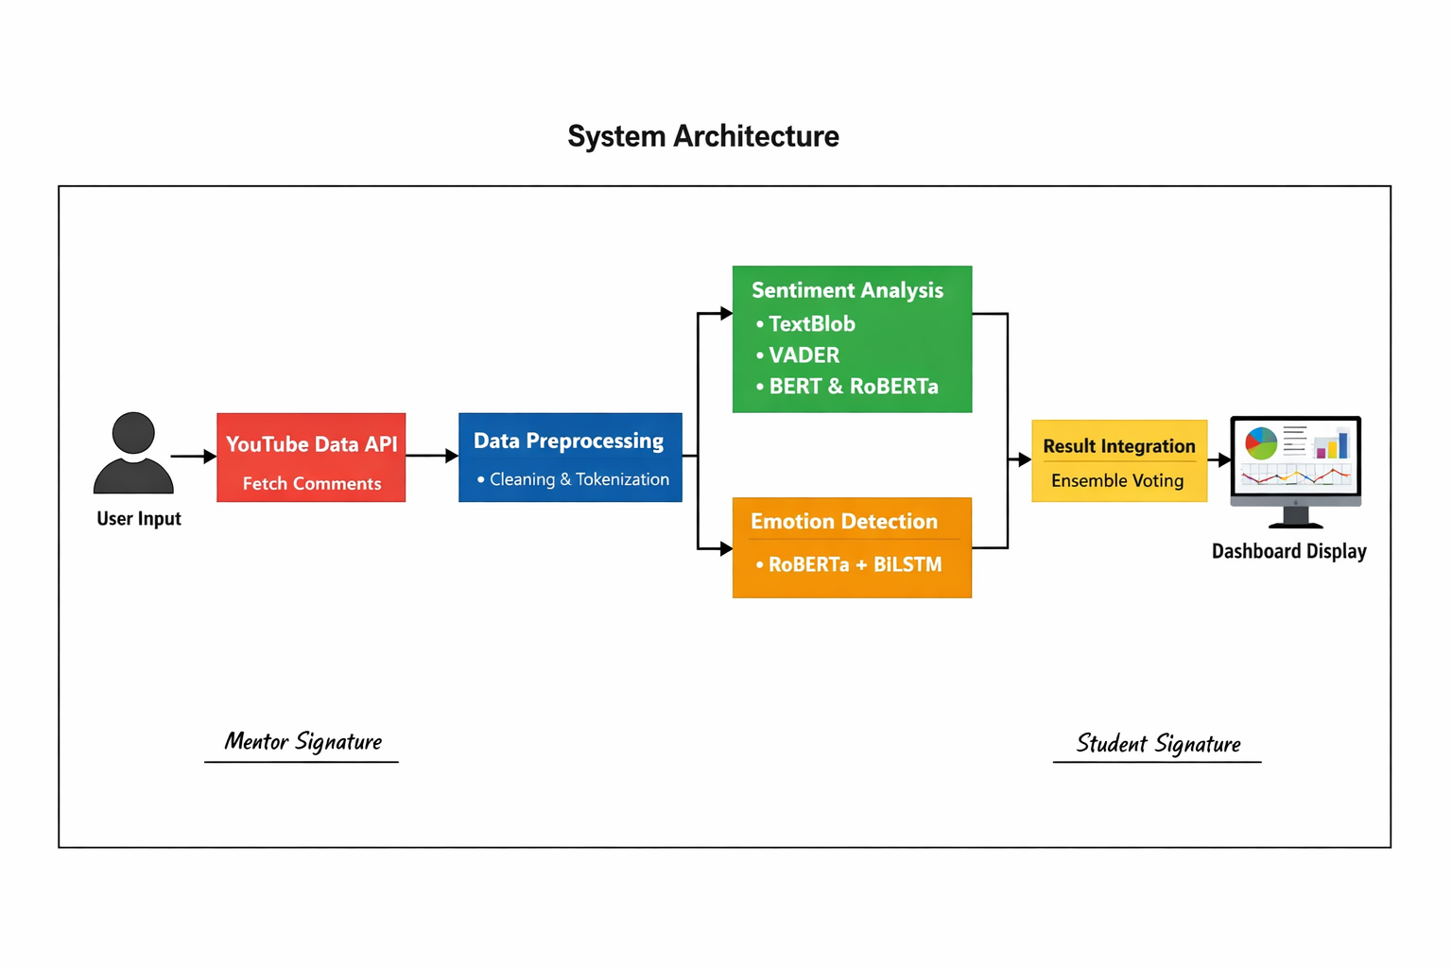
SYSTEM ARCHITECTURE

Slide 10
METHODS AND TECHNIQUES
Data Collection: YouTube Data API
Text Preprocessing: Cleaning, tokenization, stopword removal
Sentiment Analysis: TextBlob, VADER, BERT, RoBERTa
Emotion Detection: Deep learning-based emotion classification
Ensemble Technique: Combining multiple model outputs
Visualization: Graphs and charts using Streamlit

Slide 11
MODULES DESCRIPTION
User Interface Module
User provides YouTube video link
Displays sentiment and emotion results
Data Collection Module
Fetches comments using YouTube Data API
Preprocessing Module
Removes noise, spam, and irrelevant text
Sentiment Analysis Module
Classifies comments into sentiment categories
Emotion Analysis Module
Identifies emotions like joy, anger, fear, and sadness
Visualization Module
Displays results using charts and dashboards

Slide 12
REQUIREMENT ANALYSIS
FUNCTIONAL REQUIREMENTS
Accept YouTube video link as input
Fetch and process YouTube comments
Perform sentiment and emotion analysis
Display analysis results visually
NON-FUNCTIONAL REQUIREMENTS
System should be user-friendly
Response time should be minimal
High accuracy in sentiment classification
Secure handling of API keys

Slide 13
REQUIREMENT ANALYSIS
SOFTWARE REQUIREMENTS
Programming Language: Python
IDE: VS Code
Libraries: NumPy, Pandas, NLTK, SpaCy
Deep Learning Frameworks: TensorFlow
NLP Models: TextBlob, VADER, BERT, RoBERTa
API: YouTube Data API
Visualization Tool: Streamlit
HARDWARE REQUIREMENTS
Processor: Intel i5 or higher
RAM: Minimum 8 GB
Storage: 20 GB free space
Internet connection

Slide 14
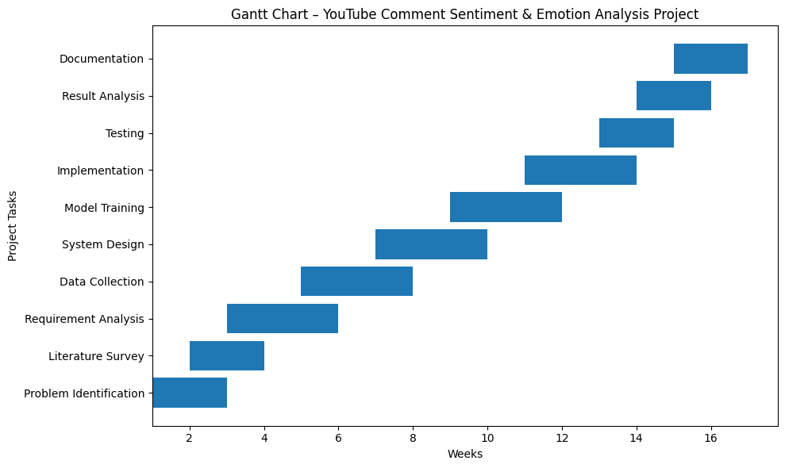
GANTT CHART

Slide 15
CONCLUSION
This project helps to understand people’s opinions from YouTube comments easily.
It saves time by automatically analyzing a large number of comments.
The system works for different languages and mixed-language comments.
The results are shown in simple graphs, making them easy to understand.

Slide 16
REFERENCES
[1] A. Amangeldi et al., "Understanding Environmental Posts: Sentiment and Emotion Analysis of Social Media Data," IEEE Transactions on Computational Social Systems, vol. 11, no. 2, pp. 1-10, 2024.
[2] I. Ibrohim et al., "Sentiment Analysis for the Natural Environment: A Systematic Review," Journal of Artificial Intelligence Research, vol. 15, no. 4, pp. 50-65, 2024.
[3] B. Bryan-Smith et al., "Real-Time Social Media Sentiment Analysis for Rapid Impact Assessment," IEEE Access, vol. 30, no. 5, pp. 1200-1215, 2023.

Slide 17
[4] A. Tolebav Nurlanuly, “Sentiment Analysis of Texts from Social Networks Based on Machine Learning Methods,” Journal of Information Processing Systems, vol. 19, no. 3, pp. 420–432, 2025.
[5] S. Arun Kumar and A. Geetha, “Emotion Detection from Text Using NLP Techniques,” International Journal of Intelligent Systems and Applications in Engineering, vol. 12, no. 14S, pp. 609–615, 2024.
[6] D. Vidhya, G. Sivaselvan, and V. Vennila, “Techniques of Opinion Mining and Sentiment Analysis: A Survey,” Int. J. Commun. Comput. Technol., vol. 3, no. 2, pp. 72–78, 2023.

Slide 18
THANK YOU

